Slide 1
Linear Regression
Chapter 8

Slide 2
What is Regression?
A way of predicting the value of one variable from another.
It is a hypothetical model of the relationship between two variables.
The model used is a linear one.
Therefore, we describe the relationship using the equation of a straight line.

Slide 3
Model for Correlation
Outcome_{i} = (bX_{i} ) + error_{i}
Remember we talked about how b is standardized (correlation coefficient, r) to be able to tell the strength of the model
Therefore, r = model+strength instead of M + error.

Slide 4
Describing a Straight Line
b_{i}
Regression coefficient for the predictor
Gradient (slope) of the regression line
Direction/Strength of Relationship
b₀
Intercept (value of Y when X = 0)
Point at which the regression line crosses the Y-axis (ordinate)

Slide 5
Intercepts and Gradients

Slide 6
Types of Regression
Simple Linear Regression = SLR
One X variable (IV)
Multiple Linear Regression = MLR
2 or more X variables (IVs)

Slide 7
Types of Regression
MLR Types
Simultaneous
Everything at once
Hierarchical
IVs in steps
Stepwise
Statistical regression (not recommended)

Slide 8
Analyzing a regression
Is my overall model (i.e. the regression equation) useful at predicting the outcome variable?
Model summary, ANOVA, R²
How useful are each of the individual predictors for my model?
Coefficients box, pr²

Slide 9
Overall Model
Remember that ANOVA was a subtraction of different types of information
SStotal = My score – Grand Mean
SSmodel = My level – Grand Mean
SSresidual = My score – My level
(for one-way ANOVAs)
This method is called least squares

Slide 10
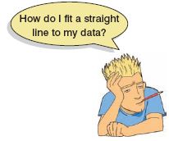
The Method of Least Squares

Slide 11
Sums of Squares

Slide 12
Summary
SS_{T}
Total variability (variability between scores and the mean).
My score – Grand mean
SS_{R}
Residual/Error variability (variability between the regression model and the actual data).
My score – my predicted score
SS_{M}
Model variability (difference in variability between the model and the mean).
My predicted score – Grand mean

Slide 13
Overall Model: ANOVA
SS_{T}
Total Variance In The Data
SS_{M}
SS_{R}
Improvement Due to the Model
Error in Model
If the model results in better prediction than using the mean, then we expect SS_{M} to be much greater than SS_{R}

Slide 14
Overall Model: ANOVA
Mean Squared Error
Sums of Squares are total values.
They can be expressed as averages.
These are called Mean Squares, MS

Slide 15
Overall Model: R²
R²
The proportion of variance accounted for by the regression model.
The Pearson Correlation Coefficient Squared

Slide 16
Individual Predictors
We test the individual predictors with a t-test.
Think about ANOVA > post hocs … this order follows the same pattern.
Single sample t-test to determine if the b value is greater than zero
(test statistic = b / SE) = also the same thing we’ve been doing … model / error

Slide 17
Individual Predictors
t values are traditionally reported, but SPSS does not give you df to report appropriately.
df = N – k – 1
N = total sample size, k = number of predictors
So correlation = N – 1 – 1 = N – 2
(what we did last week)
Also dfresidual

Slide 18
Individual Predictors
b = unstandardized regression coefficient
For every one unit increase in X, there will be b units increase in Y.
Beta = standardized regression coefficient
b in standard deviation units.
For every one SD increase in X, there will be b SDs increase in Y.

Slide 19
Individual Predictors
b or beta? Depends:
b is more interpretable given your specific problem
Beta is more interpretable given differences in scales for different variables

Slide 20
Data Screening
Now, generally everything is continuous, and numbers are given to us by the participants (i.e. there aren’t groups)
We will cover what to do when there are in the moderation section.

Slide 21
Data Screening
Now we want to look specifically at the residuals for Y … while screening the X variables
We used a random variable before to check the continuous variable (the DV) to make sure they were randomly distributed

Slide 22
Data Screening
Now we don’t need the random variable because the residuals for Y should be randomly distributed (and evenly) with the X variable
So we get to data screen with a real regression
(rather than the fake one used with ANOVA).

Slide 23
Data Screening
Missing and accuracy are still screened in the same way
Outliers – (somewhat) new and exciting!
Multicollinearity – same procedure**
Linearity, Normality, Homogeneity, Homoscedasticity – same procedure

Slide 24
SPSS
C8 regression data
CESD = depression measure
PIL total = measure of meaning in life
AUDIT total = measure of alcoholism
DAST total = measure of drug usage

Slide 25
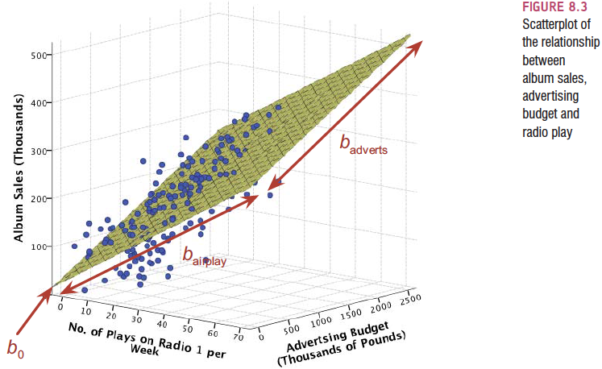
Multiple Regression

Slide 26
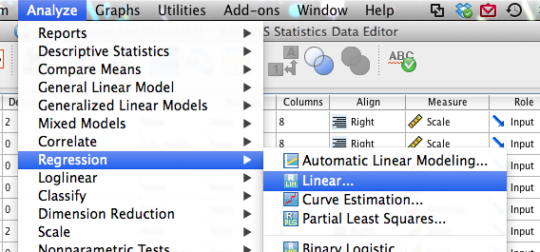
SPSS
Let’s try a multiple linear regression using alcohol + meaning in life to predict depression
Analyze > regression > linear

Slide 27
SPSS
Move the DV into the dependent box
Move over the IVs into the predictor box
(so this is a simultaneous regression)

Slide 28
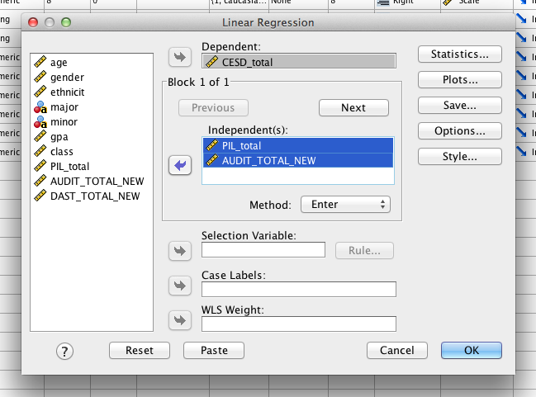
SPSS

Slide 29
SPSS
Hit Statistics
R squared change (mostly hierarchical)
Part and partials
Confidence intervals (cheating at correlation)

Slide 30
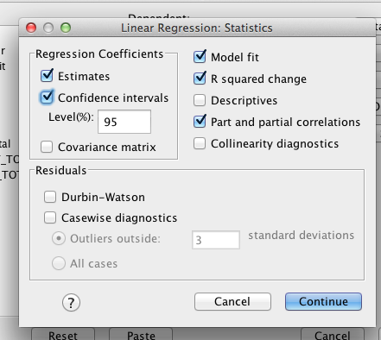
SPSS

Slide 31
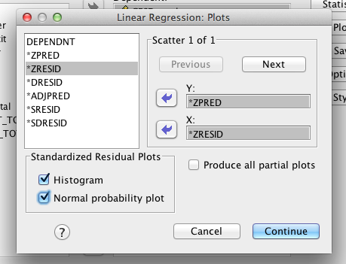
SPSS
Hit Plots
ZPRED in Y
ZRESID in X
Histogram
PP Plot

Slide 32
SPSS
Hit Save
Cook’s
Leverage
Mahalanobis
Studentized
Studentized deleted

Slide 33
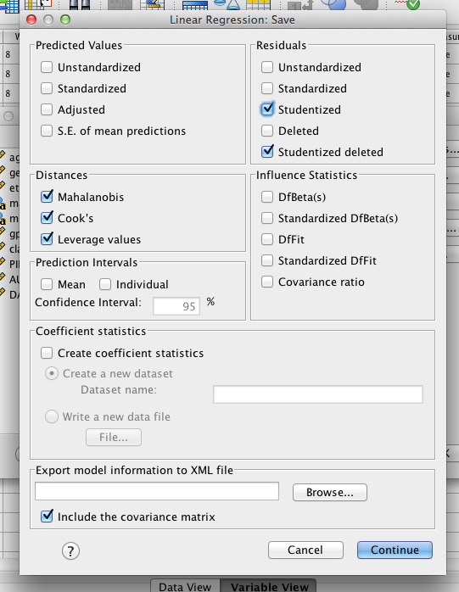
SPSS

Slide 34
Data Screening
Outliers
Standardized residuals – a z-score of how far away a person is from the regression line
Studentized residuals – a z-score of how far away a person is from the regression line, but estimated a slightly different way.

Slide 35
Data Screening
Outliers
Studentized deleted residual – how big the residual would be for someone if they were not included in the regression line calculation
What do the numbers mean?
These are z-scores, and we want to use the p< .001 cut off, therefore 3.29 is bad (most people use the 3 rule we’ve learned before).
Use the absolute value.

Slide 36
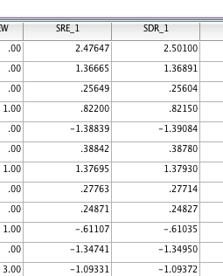
SPSS
SRE – studentized residual
SDR – studentized deleted residual

Slide 37
Data Screening
Outliers
DFBeta, DFFit – differences in intercepts, predictors, and predicted Y values when a person is included versus excluded.
If you use the standardized versions, >1 are bad.
(mostly not used in psychology that I have seen…)

Slide 38
Data Screening
Outliers
Leverage – influence of that person on the slope
What do these numbers mean?
(2K+2)/N

Slide 39
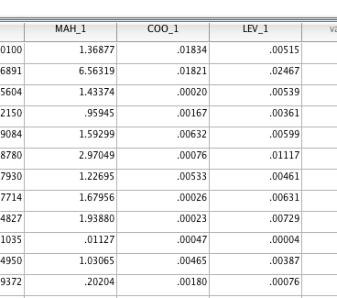
SPSS

Slide 40
Data Screening
Outliers
Influence (Cook’s values) – a measure of how much of an effect that single case has on the whole model
Often described as leverage + discrepancy
What do the numbers mean?
4/(N-K-1)

Slide 41
Data Screening
Outliers
Mahalanobis! (his picture is on 307!)
Same rules as before…
Some controversy over:
1) use all the X variables
2) use all the X variables + 1 for Y
Cook’s and leverage incorporate 1 extra value …
Either way – current trend is to go with DF = number of X variables.

Slide 42
Data Screening
What do I do with all these numbers?!
Most people check out:
Leverage, Cook’s, Mahalanobis
If 2 out of 3 are bad, they are bad.
Examine studentized residuals to look at very bad fits.
erin’s column trick

Slide 43
SPSS
Make a new column
Sort your variables
Add one to participants with bad scores

Slide 44
Data Screening
Multicollinearity
You want X and Y to be correlated
You do not want the Xs to be highly correlated
It’s a waste of power (dfs)

Slide 45
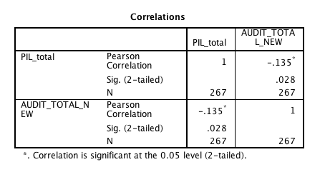
SPSS
Analyze > correlate > bivariate
Usually just X variables since you want X and Y to be correlated
Collinearity diagnostics

Slide 46
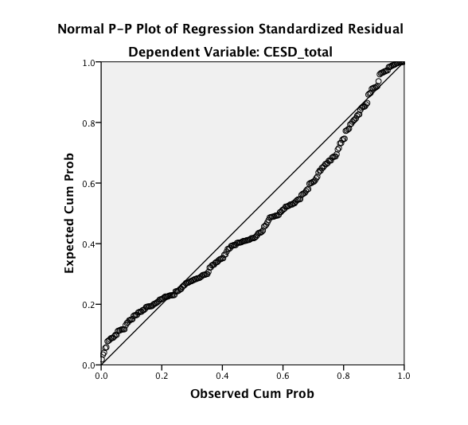
Data Screening
Linearity – duh.

Slide 47
Data Screening
Normality of the errors – we want to make sure the residuals are centered over zero (same thing you’ve been doing) … but we don’t really care if the sample is normal.

Slide 48
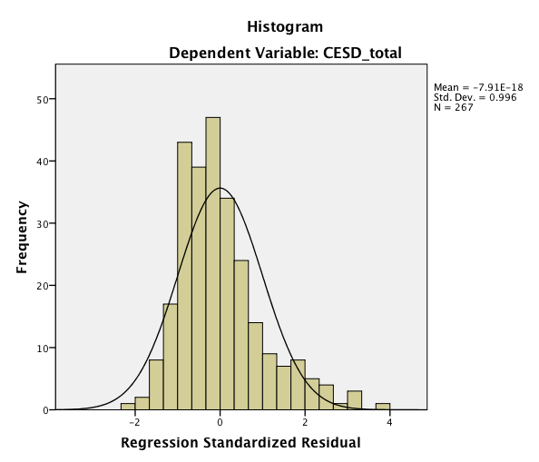
SPSS

Slide 49
Data Screening
Homogeneity / Homoscedasticity
Now it is really about Homoscedasticity…

Slide 50
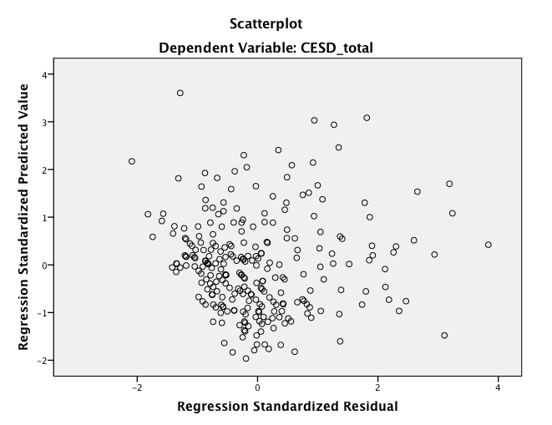

Slide 51
Data Screening
Some other assumptions:
Independence of residuals for X
X variables are categorical (with 2 categories) or at least interval
Y should be interval (categorical = log regression)
X/Y should not show restriction of range

Slide 52
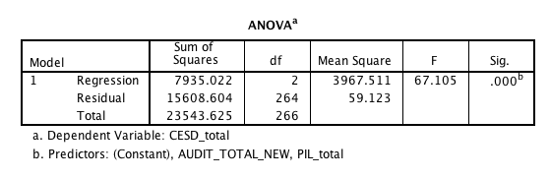
Overall Model
Here are the SS values…
- Generally this box is ignored (we will talk about hierarchical uses later).

Slide 53
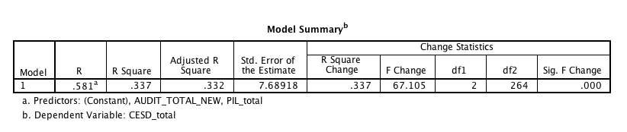
Overall Model
This box is more useful!
R = correlation of Xs + Y
R² = effect size of overall model
F-change = same as ANOVA, tells you if R > 0 or if your model is significant
F(2, 264) = 67.11, p<.001, R² = .34

Slide 54
R
Multiple correlations = sr
All overlap in Y
A+B+C/A+B+C+D
IV 1
DV Variance
D
A
IV 2
B
C

Slide 55
SR
Semipartial correlations = sr = part in SPSS
Unique contribution of IV to R2 for those IVs
Increase in proportion of explained Y variance when X is added to the equation
A/A+B+C+D
IV 1
DV Variance
D
A
IV 2
B
C

Slide 56
PR
Partial correlation = pr = partial in SPSS
Proportion in variance in Y not explained by other predictors but this X only
A/D
Pr > sr
IV 1
DV Variance
D
A
IV 2
B
C

Slide 57
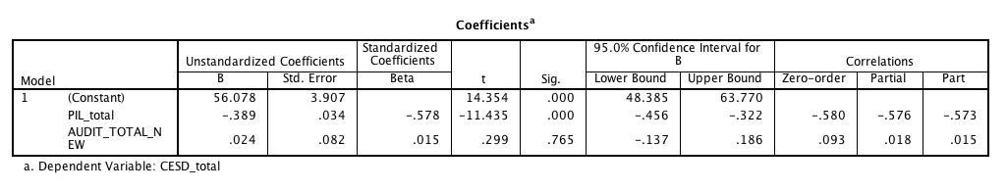
Individual Predictors
PIL total seems to be the stronger predictor and is significant
β = -.58, t(264) = -11.44, p<.001, pr² = .33
AUDIT is not significant.
β = .02, t(264) = .30, p = .77, pr² < .01

Slide 58
Hierarchical Regression + Dummy Coding

Slide 59
Hierarchical Regression
Known predictors (based on past research) are entered into the regression model first.
New predictors are then entered in a separate step/block.
Experimenter makes the decisions.

Slide 60
Hierarchical Regression
It is the best method:
Based on theory testing.
You can see the unique predictive influence of a new variable on the outcome because known predictors are held constant in the model.
Bad Point:
Relies on the experimenter knowing what they’re doing!

Slide 61
Hierarchical Regression
Answers the following questions:
Is my overall model significant (ANOVA box, tests R² values against zero)?
Is the addition of each step significant (Model summary, tests delta R² values against zero)?
Are the individual predictors significant (coefficients box, tests beta against zero)?

Slide 62
Hierarchical Regression
Uses:
When a researcher wants to control for some known variables first.
When a researcher wants to see the incremental value of different variables.

Slide 63
Hierarchical Regression
Uses:
When a researcher wants to discuss groups of variables together (SETS → especially good for highly correlated variables).
When a researcher wants to use categorical variables with many categories (use as a SET).

Slide 64
Categorical Predictors
So what do you do when you have predictors with more than 2 categories?
DUMMY CODING
Dummy coding is a way to put categorical predictors into separate pairwise columns to be able to use them as SETs (in a hierarchical regression).

Slide 65
Categorical Predictors
Use the number of groups minus 1 = the number of columns you need to create
Choose one group to be the baseline or control group
The baseline groups gets ALL ZERO values.

Slide 66
Categorical Predictors
For your first variable, assign the second group all ONE values.
Everyone else is a zero.
For the second variable, assign the third group all ONE values.
Everyone else is a zero.
Etc.

Slide 67
Categorical Predictors
Dummy coded variables are treated as a set (for R² prediction purposes), so they go in all the same block (step).
Interpretation
For each variable, the control group (all zero group) versus the group with one codings

Slide 68
Categorical Predictors
Example!
C8 dummy code.sav

Slide 69
Categorical Predictors
So we’ve got a bunch of treatment variables, under treat.
But we can’t use that as a straight predictor, because SPSS will interpret the codes as a linear relationship.

Slide 70
Categorical Predictors
So, we are going to dummy code them.
How many do we have?
5
So how many columns do we need?

Slide 71
Categorical Predictors
Create that number of new columns
Pick a control group (no treatment!)
Give the control group all zeros.

Slide 72
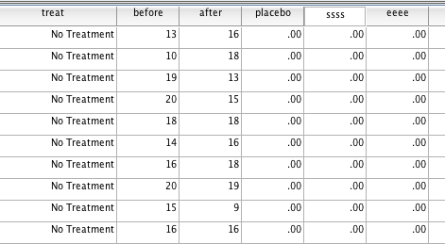
Categorical Predictors

Slide 73
Categorical Predictors
Enter ones in the appropriate places for each group.
 | Var1 | Var2 | Var3 | Var4
None | 0 | 0 | 0 | 0
Placebo | 1 | 0 | 0 | 0
Seroxat | 0 | 1 | 0 | 0
Effexor | 0 | 0 | 1 | 0
Cheer up | 0 | 0 | 0 | 1

Slide 74
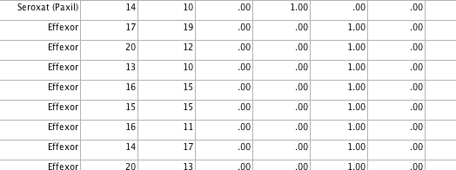
Categorical Predictors

Slide 75
Hierarchical Regression
All the rules for data screening stay the same.
Accuracy, missing
Outliers (cooks, leverage, Mahalanobis – 2/3 = outlier)
Multicollinearity
Normality
Linearity
Homoscedasticity

Slide 76
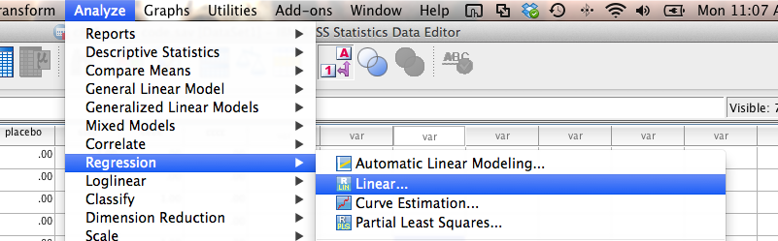
Hierarchical Regression
Analyze > regression > linear

Slide 77
Hierarchical Regression
Move the dv into the dependent variable box.
Move the first IV into the independent(s) box.
HIT NEXT.

Slide 78
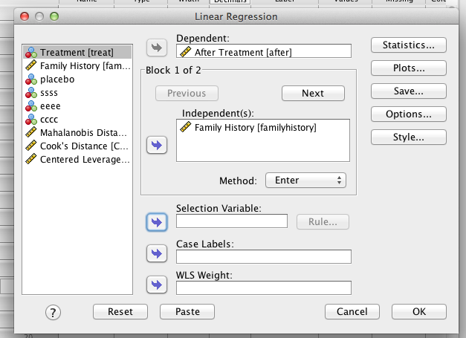
Hierarchical Regression

Slide 79
Hierarchical Regression
Move over the other IV(s) into the independent(s) box.
Here we are going to move all the new dummy codes over.

Slide 80
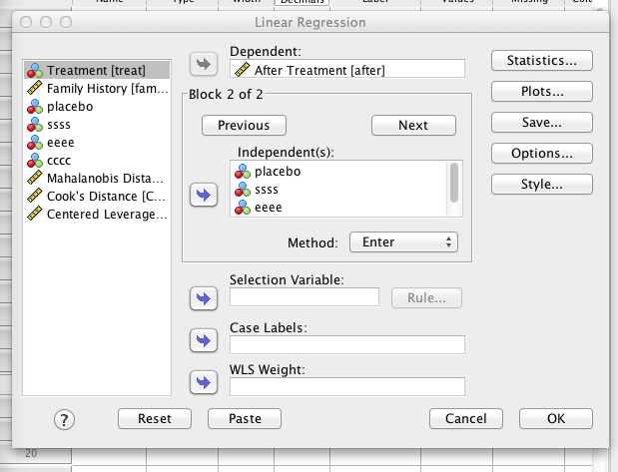
Hierarchical Regression

Slide 81
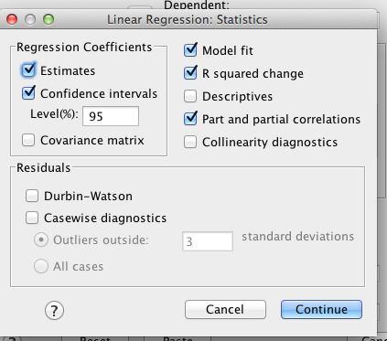
Hierarchical Regression
Statistics:
R square change
Part and partials

Slide 82
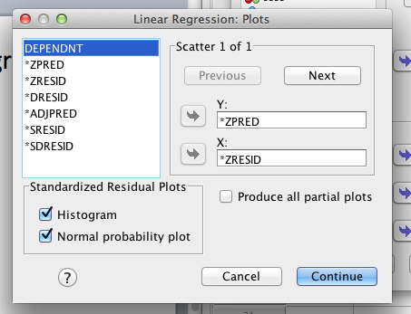
Hierarchical Regression

Slide 83
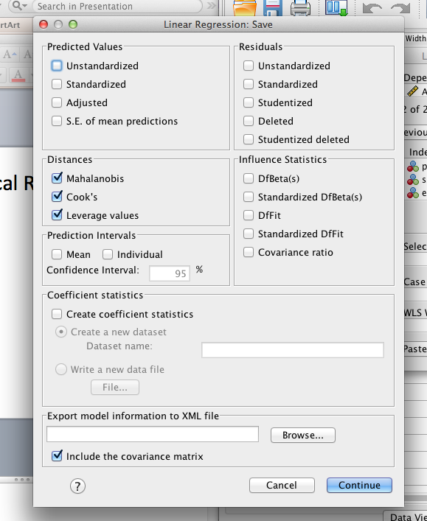
Hierarchical Regression

Slide 84
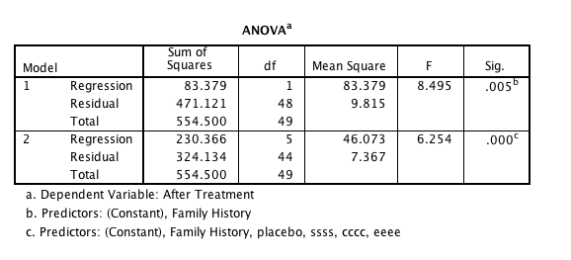
Hierarchical Regression
Is my overall model significant?

Slide 85
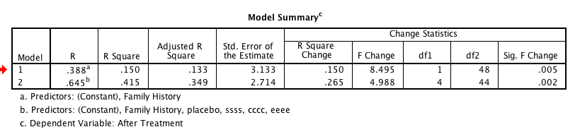
Hierarchical Regression
Are the incremental steps significant?

Slide 86
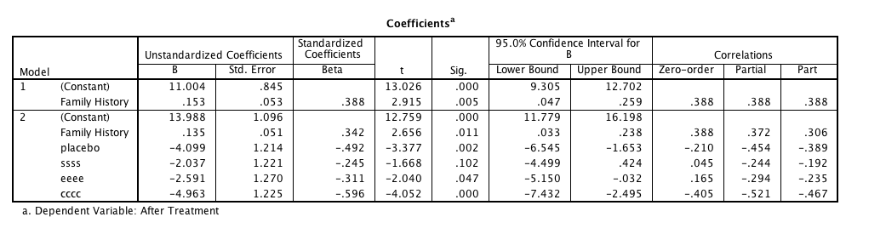
Hierarchical Regression
Are the individual predictors significant?

Slide 87
Hierarchical Regression
Remember dummy coding equals:
Control group to coded group
Therefore negative numbers = coded group is lower
Positive numbers = coded group is lower
b = difference in means

